Slide 1




WELCOME
THE SEARCH-INSERT-DELETE PROBLEM

Slide 2


Group Members
Aiman Malik
Samreen Razzaq
Urwah Imran
Ayesha

Slide 3
﻿Table Of Contents
Introduction to Problem Statement
1
2
Understanding the Code
3
Results
4
Conclusion
5
Future Work and Applications

Slide 4
Abstract
The “Search-Delete-Insert-Problem”, a concurrency challenge in operating system
Shares access to a singly linked list.
Categorized into three-way mutual exclusion
Searchers can run concurrently, Insertions require mutual exclusion, and Deletion should be mutually exclusive with searches and insertions

Slide 5
Introduction
Searchers operate concurrently, merely examining the list
An inserter can proceed in parallel with any number of searches
Deleters must have exclusive access limiting them to one process at a time and necessitating mutual exclusion with searches and insertions

Slide 6
"Concurrency Challenge: Search-Insert-Delete Problem"
Briefly introduce the "Search-Insert-Delete" concurrency challenge with a singly-linked list.
Highlight the involvement of three threads: Searchers, Inserters, and Deleters.
Emphasize the main goal: Ensuring thread-safe operations to avoid conflicts during concurrent accesses.

Slide 7
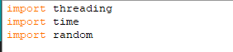
Code Overview
Discuss the three essential imports: threading, time, and random.
Elaborate on the role of each import: threading for managing threads, time for time-related functions, and random for generating random numbers.
Connect the imports to the broader context of the code's functionality.

Slide 8
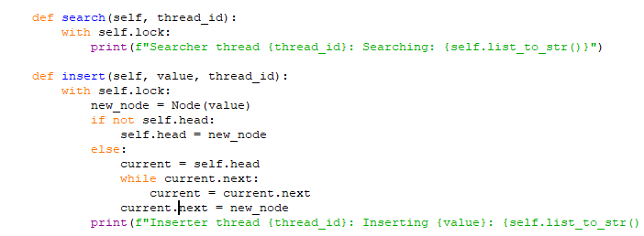
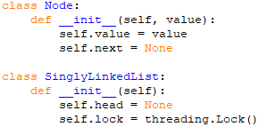
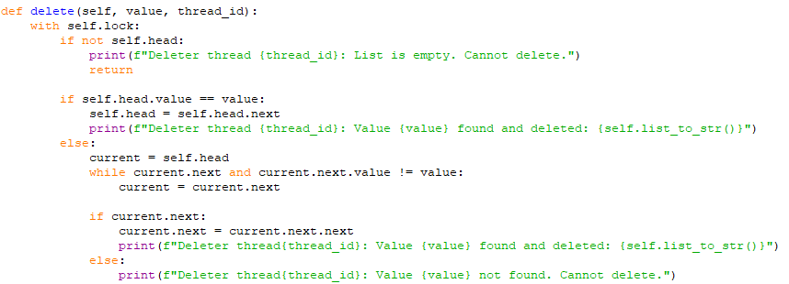
Program Setup and Threading Mechanism

Slide 9
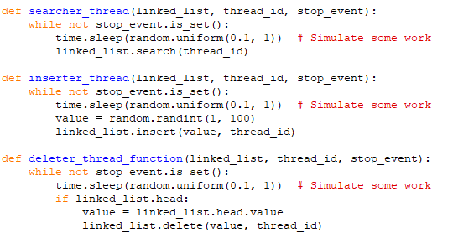
Thread Functions and Real-world Simulation

Slide 10
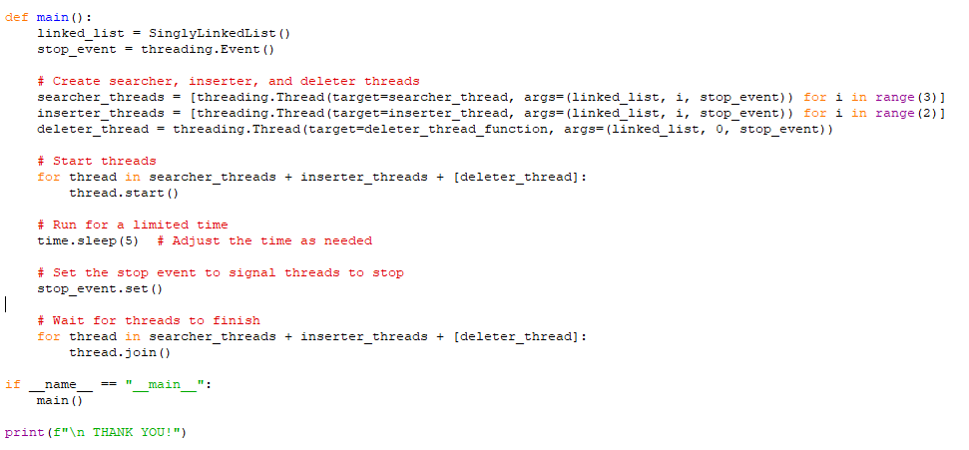
Main Function
Initialization and Thread Creation
Thread Start and Simulation .
Stop and Join Thread .

Slide 11
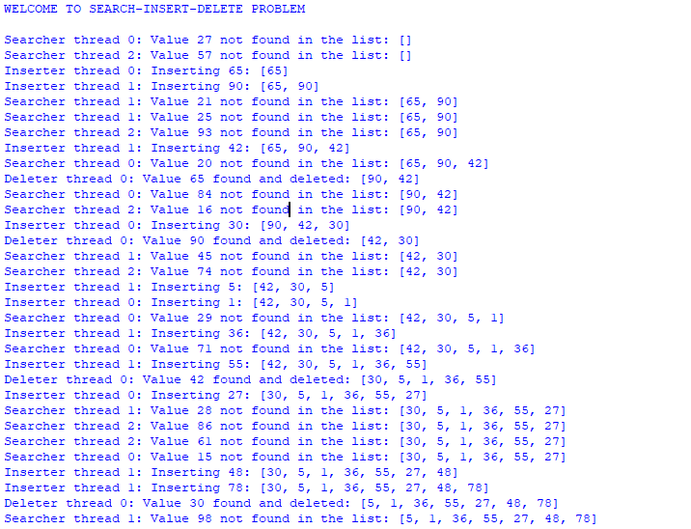
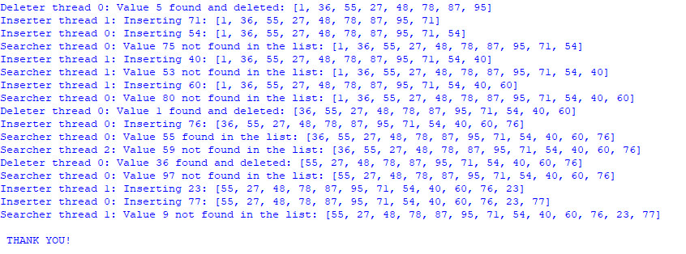
Result/Output

Slide 12
Conclusion
Implement the Search-Insert-Delete problem using multithreading.
Utilizes the threading module to create searcher, inserter, and deleter threads.
Each thread performs its specific operation on a singly-linked list.
Ensures mutual exclusion through a thread lock mechanism to prevent conflicts.
Ensures threads terminate gracefully for comprehensive simulation.
Underscores the importance of synchronization mechanisms for managing shared resources effectively.

Slide 13
Future Works And Applications in Operating System
Advanced Synchronization Techniques.
Lock-Free and Wait-Free Data Structures.
Integration into Modern Operating Systems.
Real-World Application Extensions.
Practical Implementations and Benchmarks.
Efficient and Scalable Resource Management.

Slide 14
﻿THANK YOU

